Slide 1




Modern AI Techniques to Understand the Spatio-temporal Spread of Invasive Alien Plants: Approaches and Challenges
Aniruddha Adiga, Ethan Choo, Pramod Jha, Krishna Poudel, Srinivasan
Venkatramanan, Madhav Marathe, Abhijin Adiga
Biocomplexity Institute and Initiative
Notes:
Acknowledge: Sharma, Ramamurthy, Shashank

Slide 2
Theme
Climate change and intensification of human activities have led to an explosion of invasive species introductions and their rapid proliferation.
Their effect is amplified in biodiversity hotspots such as Nepal due to its unique physiographic properties. Several invasive alien plants are a threat to the biodiversity and agriculture.
Identifying the pathways/mechanisms of their spread, and accurately predicting their future course is of utmost importance.
We are applying modern AI techniques to address these problems with multi-resolution remote sensing data.

Slide 3


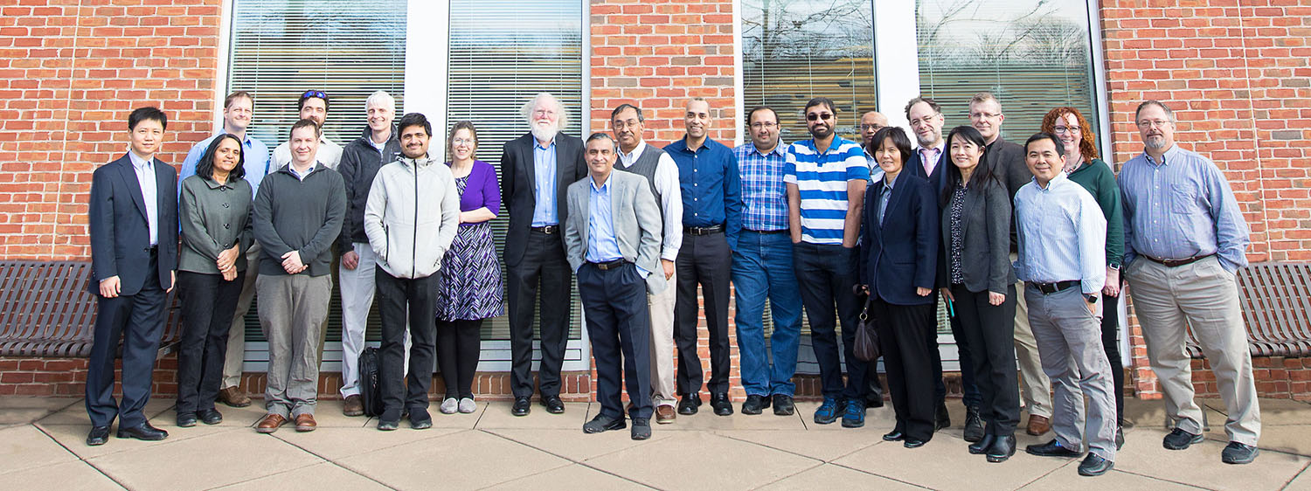
Funding and team
NSSAC, BII, UVA
Notes:
Background here: CS background, current work: modeling
Evening walk

Slide 4
Outline
Introduction
Our framework
Results

Slide 5
A new paradigm: Modern AI to address biodiversity loss and food insecurity
We are seeing rapid advances data acquisition, bigdata analytics and high-performance computing.
There is a thrust towards application of these modern aritificial intelligence (AI) systems for problems at the intersection of biodiversity, agriculture and sociology.
USDA FACT
USAID Resilience in agriculture
NSF INFEWS
AI for Earth by Microsoft.
New applications are being developed to address old problems in a new manner.
Crowd-sourced data collection: PlantVillage
New image datasets for surveillance: High-resolution satetllite imagery, drones
Simulation analytics and causal models. (AA: some figures)

Slide 6
Objectives
Invasive alien species in Nepal
Seven plants affecting
land
Water bodies
Agriculture (AA: examples for each case)
Objectives:
Estimate past, current, and future distribution.
Understand mechanisms of spread.
Design policies for effective surveillance and intervention.

Slide 7
Methods
Data
Extensive survey of the CHAL region providing presence/absence information, geographic variables such as slope, colocation of other species among other variables.
Multi-resolution satellite imagery: WorldView (Digital Globe), Landsat.
Open datasets such as temperature, humidity, human population, etc.
Analytics
Deep learning or Artificial Neural Networks (ANN)
Statistical methods and GIS
Agent-based models

Slide 8
Deep Learning
(AA: I will take of this)

Slide 9
Deep Learning
Diverse applications, superior performance (particularly, image related), (almost) zero interpretability.
Has been around since 1970s.
Enabled by clever algorithms and HPC, it got a boost in the early 2000s. Enabled by availability of large amounts of data.
Promise: Hardly any work on applying it to invasive species mapping.
AA: change and add any published figure if possible (with acknowledgement)

Slide 10
Challenges in applying to invasive species detection
Data inadequacy
Difficulties with field survey.
High-resolution imagery is expensive.
Sparse coverage (unlike cropland detection).
Moderate-resolution (Landsat) might not be adequate.
Methods
Very little previous work
Class imbalance
AA: add to this if possible

Slide 11
Literature
Remote sensing and invasive species spread AA: I will take care of this

Slide 12
Literature
Nepal invasive species spread AA: I will take care of this

Slide 13
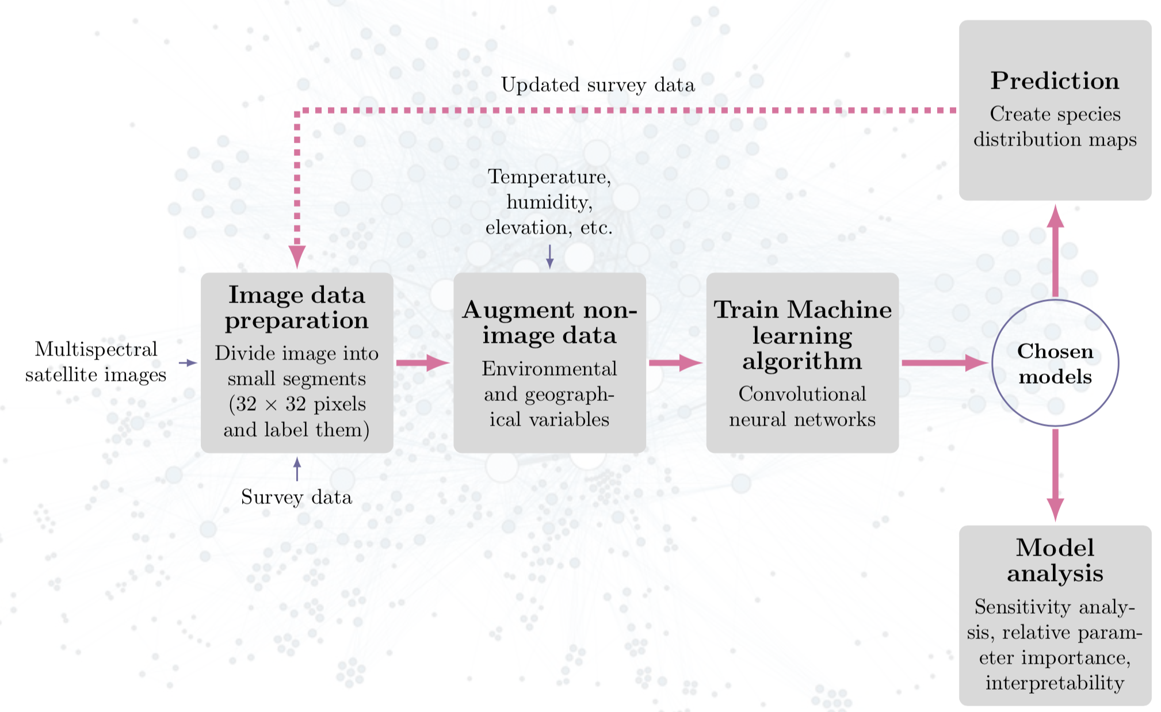
Our framework
AA: provide inputs and I will change this accordingly;
Add more slides if possible.

Slide 14
Data and experiments
Survey was conducted in two phases: Phase I and Phase II.
Experimented with multiple CNN architectures and chose the model with the best accuracy.
Training accuracy – how well the model learns the training data. Validation accuracy – how well the model generalizes to unseen data.
Phase I data: 61, 32x32, 8 band digital globe images of location where lantana is present/absent (field expert annotated).
For model parameter learning, insufficient and imbalanced data. Phase II data: 225 images
Focus species: Lantana Camara

Slide 15
Results
Trained on Phase I data, tested on unseen Phase II data: Best model: 76% accuracy
Average model: 64% accuracy
Trained on Phase II data.
Slight improvement in accuracy.
AA: need images of species distribution, more stories.

Slide 16
Ongoing work
Two main thrusts
Understanding spatiotemporal spread.
Incorporating high-resolution images: New (2019, 2018) and old (2011, 2012) Incorporating moderate-resolution images (Landsat): 10 and 20 year old images. Pending: using network models (like in T. absoluta)
Augmenting satellite imagery with Environmental/geographic variables: temperature, humidity, altitude, elevation, etc.
Interpretability/explainability

Slide 17
Questions?
abhijin@virginia.edu
abhijin@gmail.com
http://people.virginia.edu/~aa5ts/index.html
https://biocomplexity.virginia.edu/nssac

